Slide 1
Introduction to Differential Equations - Lecture 9
Fei Qi
Email: fei.qi@du.edu
Office Hour: TBA
Website: https://feiqimath.github.io

Slide 2
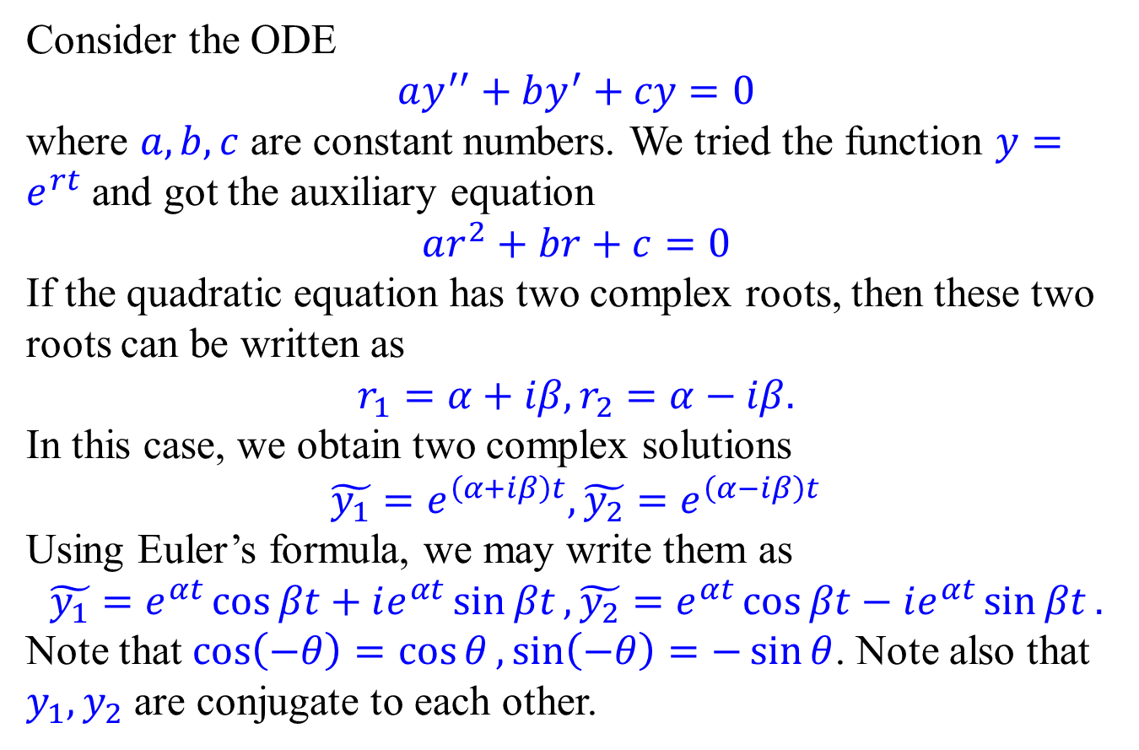
Complex roots case
Consider the ODE
$$ay^{′′}+by^{′}+cy=0$$
where $a,b,c$ are constant numbers. We tried the function $y=e^{rt}$ and got the auxiliary equation
$$ar^{2}+br+c=0$$
If the quadratic equation has two complex roots, then these two roots can be written as
$$r_{1}=α+iβ, r_{2}=α−iβ.$$
In this case, we obtain two complex solutions
$$\tilde{y_{1}}=e^{\left(α+iβ\right)t},\tilde{y_{2}}=e^{\left(α−iβ\right)t}$$
Using Euler’s formula, we may write them as
$$\tilde{y_{1}}=e^{αt}\cos{βt}+ie^{αt}\sin{βt},\tilde{y_{2}}=e^{αt}\cos{βt}−ie^{αt}\sin{βt}.$$
Note that $\cos\left(−θ\right)=\cos{θ},\sin\left(−θ\right)=−\sin{θ}$. Note also that $y_{1},y_{2}$ are conjugate to each other.

Slide 3
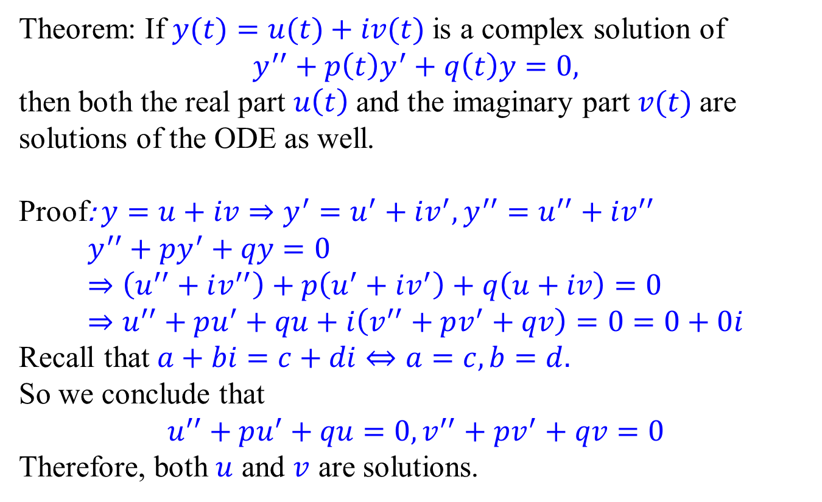
From complex solutions to real solutions
Theorem: If $y(t)=u(t)+iv(t)$ is a complex solution of
$$y^{′′}+p\left(t\right)y^{′}+q\left(t\right)y=0,$$
then both the real part $u\left(t\right)$ and the imaginary part $v(t)$ are solutions of the ODE as well.
Proof: $y=u+iv⇒y^{′}=u^{′}+iv^{′},y^{′′}=u^{′′}+iv^{′′}$
$$y^{′′}+py^{′}+qy=0 \\ ⇒\left(u^{′′}+iv^{′′}\right)+p\left(u^{′}+iv^{′}\right)+q\left(u+iv\right)=0 \\ ⇒u^{′′}+pu^{′}+qu+i\left(v^{′′}+pv^{′}+qv\right)=0=0+0i$$
Recall that $a+bi=c+di⇔a=c,b=d.$
So we conclude that
$$u^{′′}+pu^{′}+qu=0, v^{′′}+pv^{′}+qv=0$$
Therefore, both $u$ and $v$ are solutions.

Slide 4
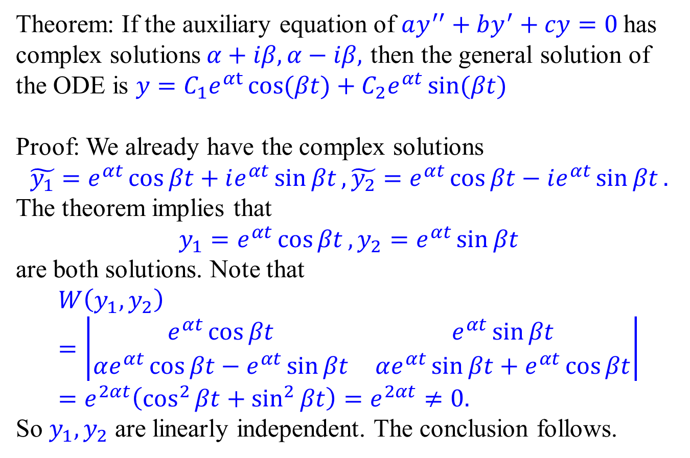
From complex solutions to real solutions
Theorem: If the auxiliary equation of $ay^{′′}+by^{′}+cy=0$ has complex solutions$α+iβ, α−iβ,$ then the general solution of the ODE is $y=C_{1}e^{αt}\cos{(βt)}+C_{2}e^{αt}\sin{(βt)}$
Proof: We already have the complex solutions
$$\tilde{y_{1}}=e^{αt}\cos{βt}+ie^{αt}\sin{βt},\tilde{y_{2}}=e^{αt}\cos{βt}−ie^{αt}\sin{βt}.$$
The theorem implies that
$$y_{1}=e^{αt}\cos{βt},y_{2}=e^{αt}\sin{βt}$$
are both solutions. Note that
$$W\left(y_{1},y_{2}\right)=\left|\begin{matrix}e^{αt}\cos{βt} & e^{αt}\sin{βt} \\ αe^{αt}\cos{βt}−e^{αt}\sin{βt} & αe^{αt}\sin{βt}+e^{αt}\cos{βt}\end{matrix}\right| \\ =e^{2αt}\left(\cos^{2}{βt}+\sin^{2}{βt}\right)=e^{2αt}≠0.$$
So $y_{1},y_{2}$ are linearly independent. The conclusion follows.

Slide 5
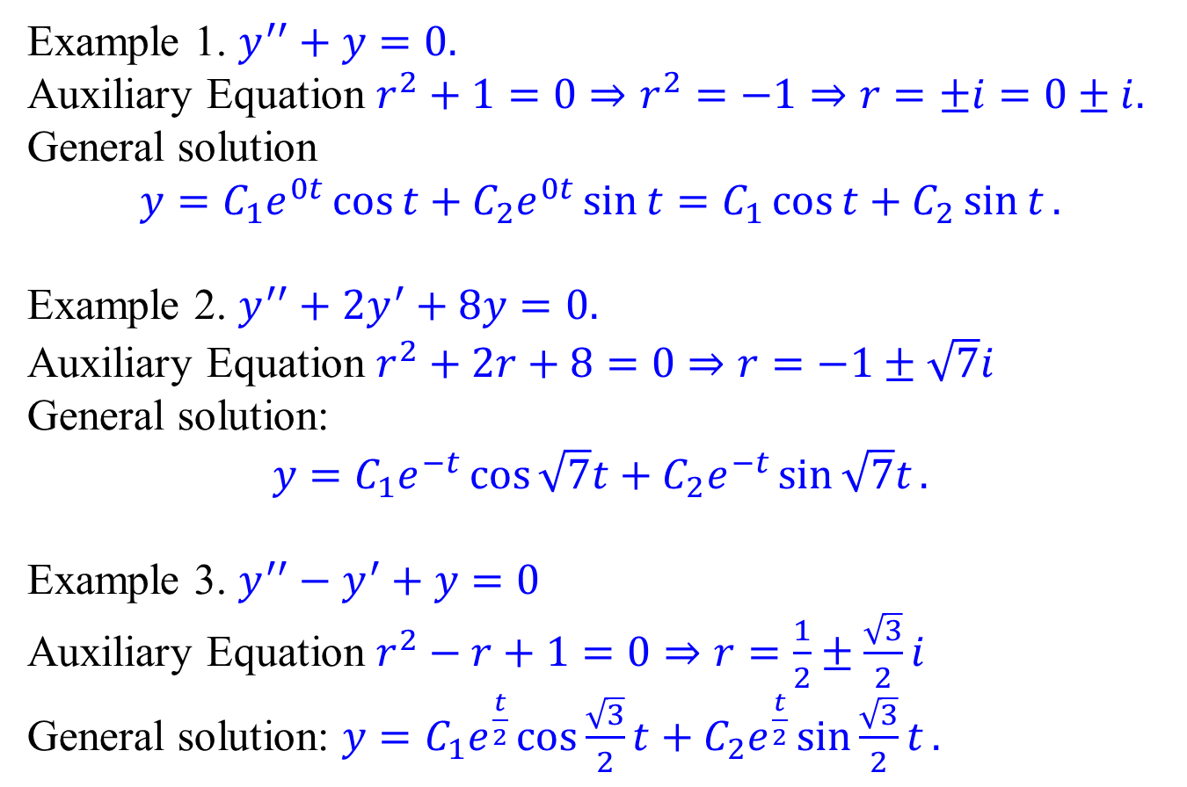
Examples
Example 1. $y^{′′}+y=0.$
Auxiliary Equation $r^{2}+1=0⇒r^{2}=−1⇒r=±i=0±i.$
General solution $$y=C_{1}e^{0t}\cos{t}+C_{2}e^{0t}\sin{t}=C_{1}\cos{t}+C_{2}\sin{t}.$$
Example 2. $y^{′′}+2y^{′}+8y=0.$
Auxiliary Equation $r^{2}+2r+8=0⇒r=−1±\sqrt{7}i$
General solution:
$$y=C_{1}e^{−t}\cos{\sqrt{7}t}+C_{2}e^{−t}\sin{\sqrt{7}t}.$$
Example 3. $y^{′′}−y^{′}+y=0$
Auxiliary Equation $r^{2}−r+1=0⇒r=\frac{1}{2}±\frac{\sqrt{3}}{2}i$
General solution: $y=C_{1}e^{\frac{t}{2}}\cos{\frac{\sqrt{3}}{2}t}+C_{2}e^{\frac{t}{2}}\sin{\frac{\sqrt{3}}{2}t}.$

Slide 6
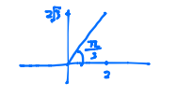
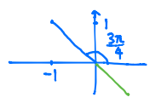

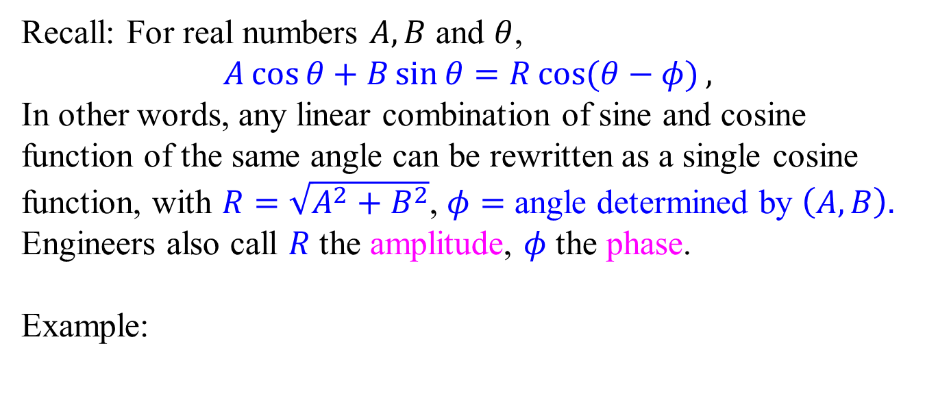

Oscillation Patterns
Recall: For real numbers $A,B$ and $θ$,
$$A\cos{θ}+B\sin{θ}=R\cos{(θ−φ)},$$
In other words, any linear combination of sine and cosine function of the same angle can be rewritten as a single cosine function, with $R=\sqrt{A^{2}+B^{2}}$, $φ=$ angle determined by $\left(A,B\right).$
Engineers also call $R$ the amplitude, $φ$ the phase.
Example:
$$2\cos{θ}+2\sqrt{3}\sin{θ} \\ =4\cos{(θ−\frac{π}{3})}$$
$$−\cos{θ}+\sin{θ} \\ =\sqrt{2}\cos\left(θ−\frac{3π}{4}\right)$$

Slide 7
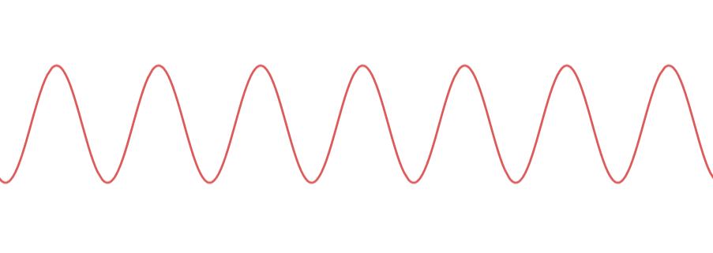
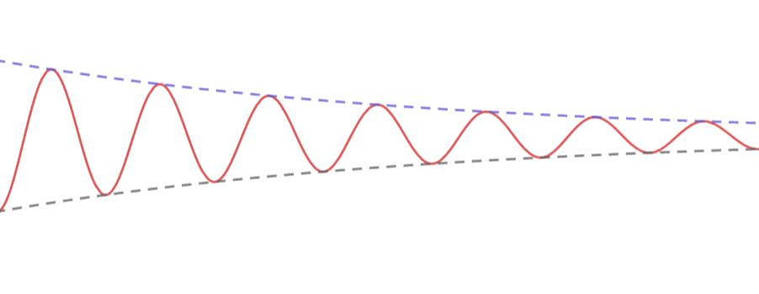
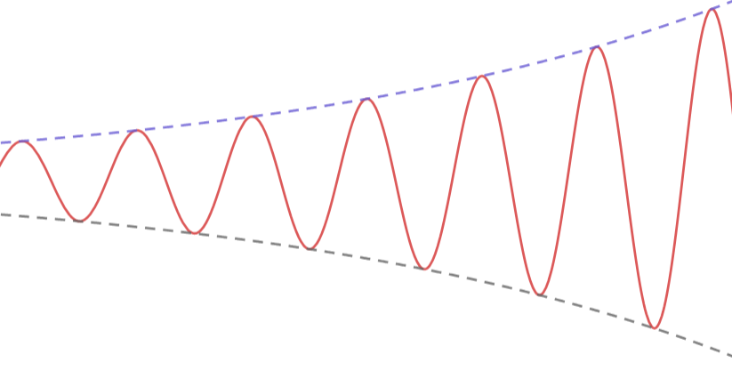

Oscillation Patterns
Example 1. $y^{′′}+y=0.$
$y=C_{1}\cos{t}+C_{2}\sin{t}$ $=\sqrt{C_{1}^{2}+C_{2}^{2}}\cos{(t−φ)}$
Example 2. $y^{′′}+2y^{′}+8y=0.$
$y=C_{1}e^{−t}\cos{\sqrt{7}t}+C_{2}e^{−t}\sin{\sqrt{7}t}$
$=\sqrt{C_{1}^{2}+C_{2}^{2}}e^{−t}\cos\left(\sqrt{7}t−φ\right)$
Example 3. $y^{′′}−y^{′}+y=0$
$y=C_{1}e^{\frac{t}{2}}\cos{\frac{\sqrt{3}}{2}t}+C_{2}e^{\frac{t}{2}}\sin{\frac{\sqrt{3}}{2}t}$ $=$ $\sqrt{C_{1}^{2}+C_{2}^{2}}e^{\frac{t}{2}}\cos\left(\frac{\sqrt{3}}{2}t−φ\right)$
Steady Oscillation
Amplitude stays still.
Decaying Oscillation
Amplitude decays exponentially.
Growing Oscillation
Amplitude grows exponentially.

Slide 8
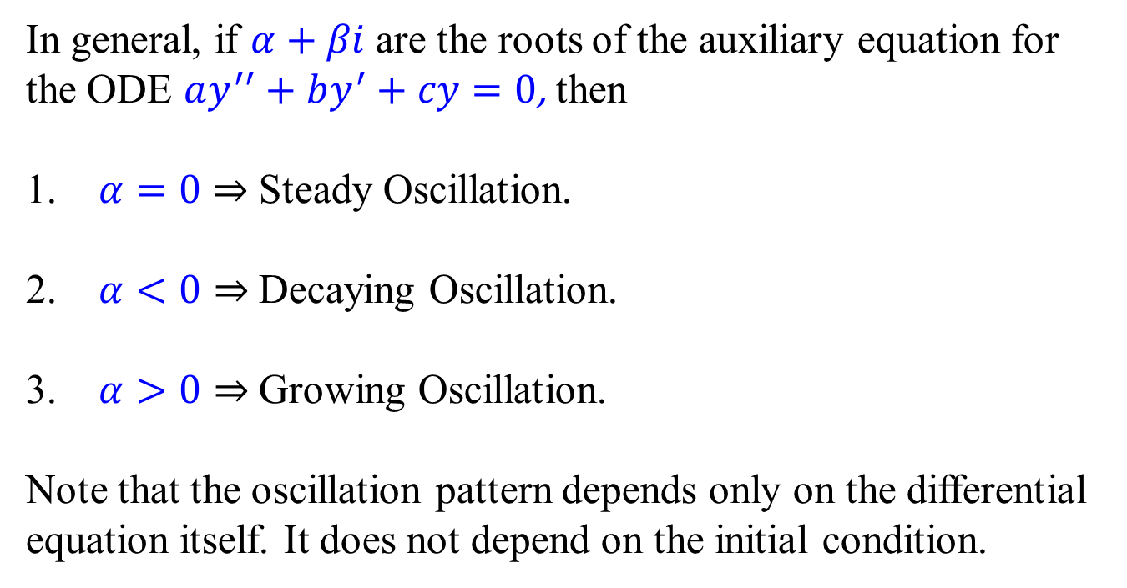
Oscillation Patterns
In general, if $α+βi$ are the roots of the auxiliary equation for the ODE $ay^{′′}+by^{′}+cy=0$, then
$α=0⇒$Steady Oscillation.
$α<0⇒$Decaying Oscillation.
$α>0⇒$Growing Oscillation.
Note that the oscillation pattern depends only on the differential equation itself. It does not depend on the initial condition.

Slide 9
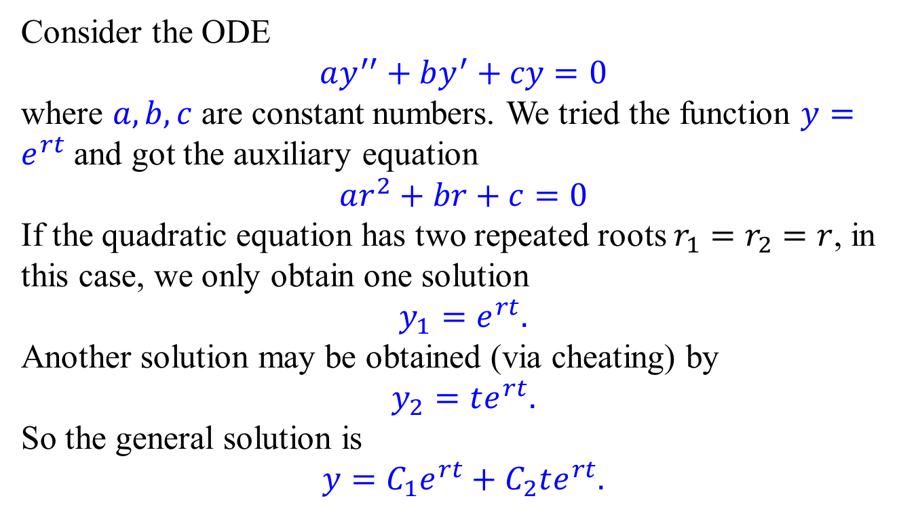
Repeated roots case
Consider the ODE
$$ay^{′′}+by^{′}+cy=0$$
where $a,b,c$ are constant numbers. We tried the function $y=e^{rt}$ and got the auxiliary equation
$$ar^{2}+br+c=0$$
If the quadratic equation has two repeated roots $r_{1}=r_{2}=r$, in this case, we only obtain one solution
$$y_{1}=e^{rt}.$$
Another solution may be obtained (via cheating) by
$$y_{2}=te^{rt}.$$
So the general solution is
$$y=C_{1}e^{rt}+C_{2}te^{rt}.$$

Slide 10
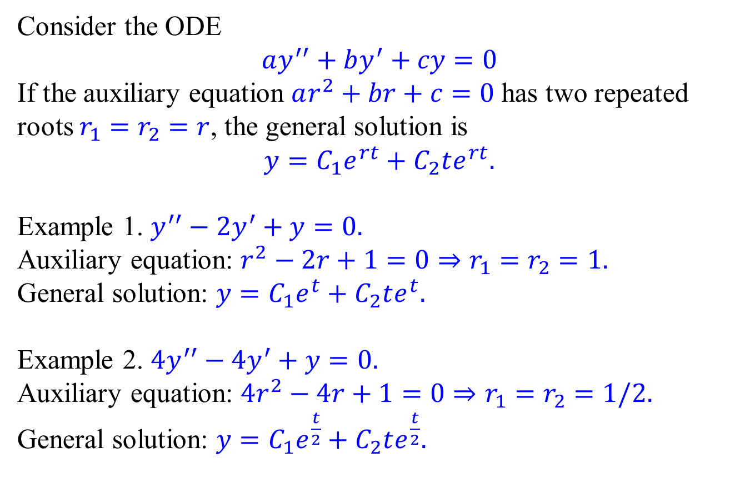
Examples
Consider the ODE
$$ay^{′′}+by^{′}+cy=0$$
If the auxiliary equation $ar^{2}+br+c=0$ has two repeated roots $r_{1}=r_{2}=r$, the general solution is
$$y=C_{1}e^{rt}+C_{2}te^{rt}.$$
Example 1. $y^{′′}−2y^{′}+y=0.$
Auxiliary equation: $r^{2}−2r+1=0⇒r_{1}=r_{2}=1.$
General solution: $y=C_{1}e^{t}+C_{2}te^{t}.$
Example 2. $4y^{′′}−4y^{′}+y=0.$
Auxiliary equation: ${4r}^{2}−4r+1=0⇒r_{1}=r_{2}=1/2.$
General solution: $y=C_{1}e^{\frac{t}{2}}+C_{2}te^{\frac{t}{2}}.$

Slide 11
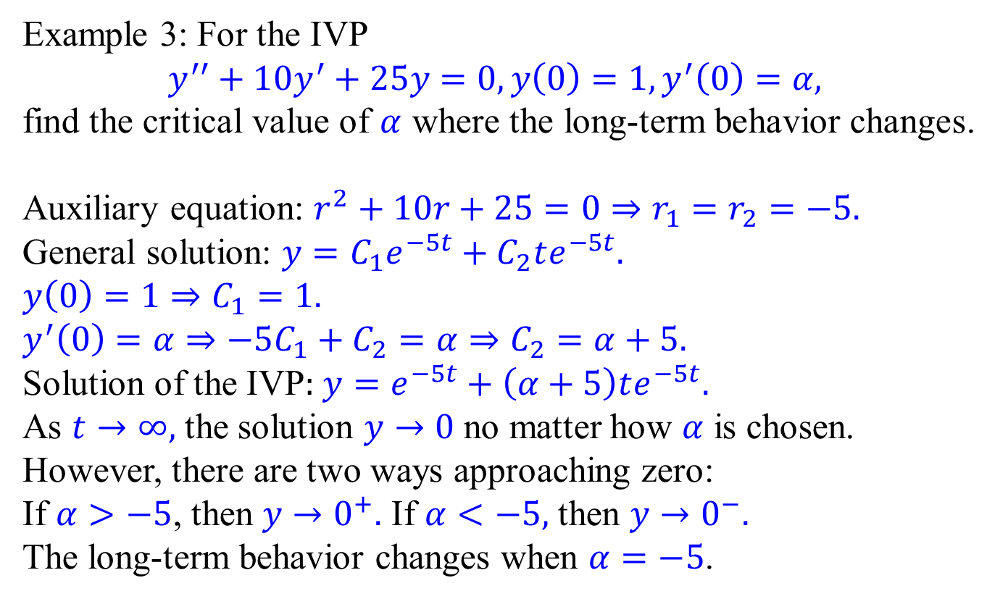
Long-term behavior
Example 3: For the IVP
$$y^{′′}+10y^{′}+25y=0,y\left(0\right)=1,y^{′}\left(0\right)=α,$$
find the critical value of $α$ where the long-term behavior changes.
Auxiliary equation: $r^{2}+10r+25=0⇒r_{1}=r_{2}=−5.$
General solution: $y=C_{1}e^{−5t}+C_{2}te^{−5t}.$
$y\left(0\right)=1⇒C_{1}=1.$
$y^{′}\left(0\right)=α⇒−5C_{1}+C_{2}=α⇒C_{2}=α+5.$
Solution of the IVP: $y=e^{−5t}+\left(α+5\right)te^{−5t}.$
As $t→∞,$ the solution $y→0$ no matter how $α$ is chosen.
However, there are two ways approaching zero:
If $α>−5$, then $y→0^{+}.$ If $α<−5,$ then $y→0^{−}.$ The long-term behavior changes when $α=−5$.

Slide 12
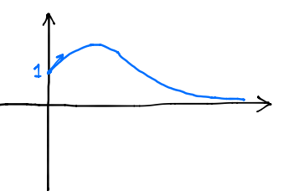
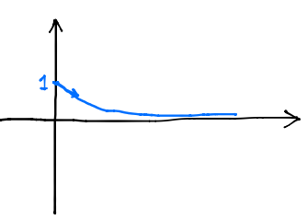
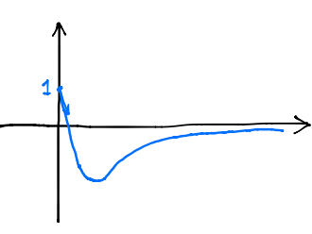
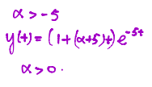
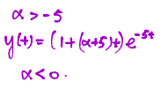

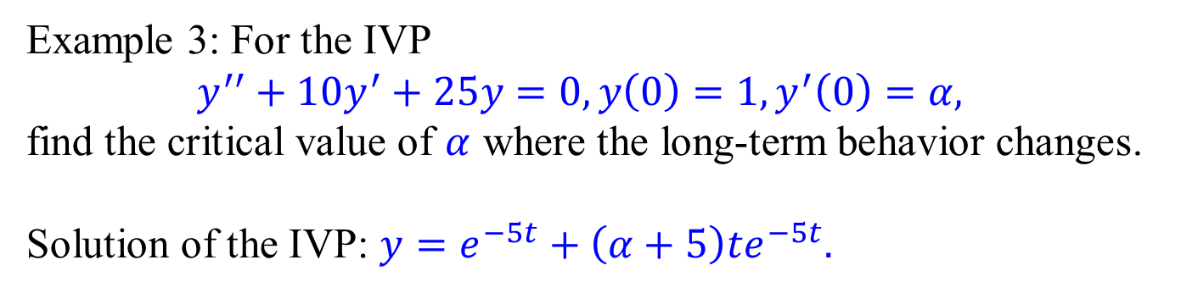
Long-term behavior
Example 3: For the IVP
$$y^{′′}+10y^{′}+25y=0,y\left(0\right)=1,y^{′}\left(0\right)=α,$$
find the critical value of $α$ where the long-term behavior changes.
Solution of the IVP: $y=e^{−5t}+\left(α+5\right)te^{−5t}.$

Slide 13
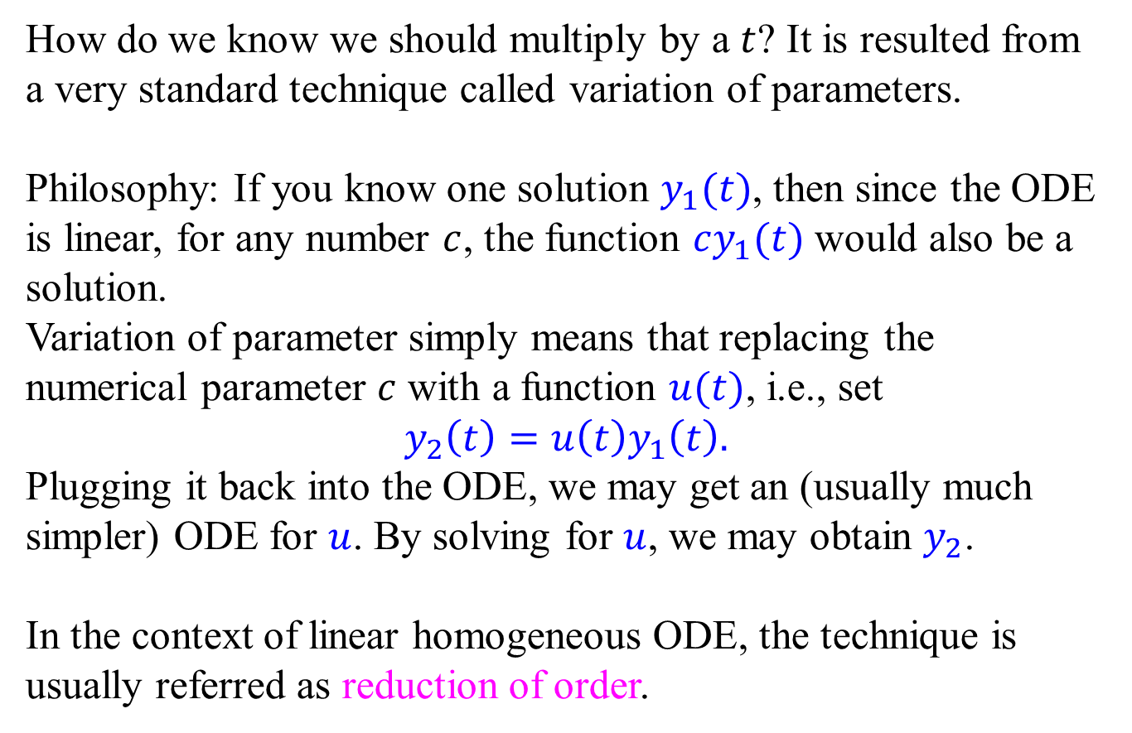
Variation of parameter
How do we know we should multiply by a $t$? It is resulted from a very standard technique called variation of parameters.
Philosophy: If you know one solution $y_{1}(t)$, then since the ODE is linear, for any number $c$, the function $cy_{1}(t)$ would also be a solution.
Variation of parameter simply means that replacing the numerical parameter $c$ with a function $u(t)$, i.e., set
$$y_{2}\left(t\right)=u\left(t\right)y_{1}\left(t\right).$$
Plugging it back into the ODE, we may get an (usually much simpler) ODE for $u$. By solving for $u$, we may obtain $y_{2}$.
In the context of linear homogeneous ODE, the technique is usually referred as reduction of order.

Slide 14
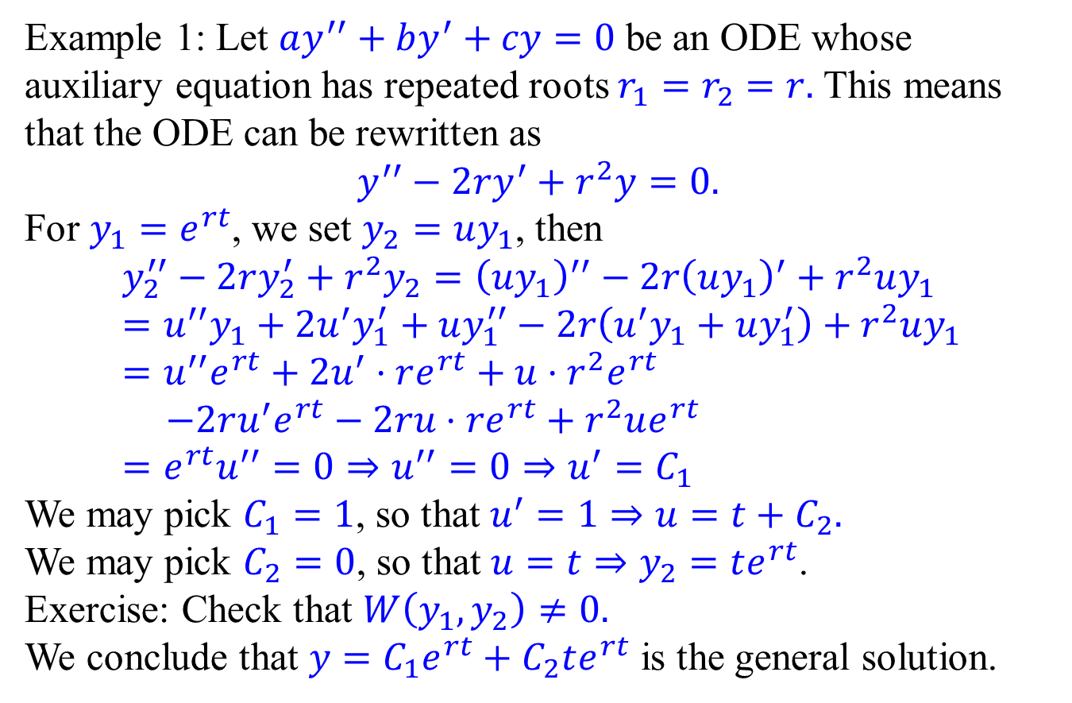
Reduction of order - Examples
Example 1: Let $ay^{′′}+by^{′}+cy=0$ be an ODE whose auxiliary equation has repeated roots $r_{1}=r_{2}=r.$ This means that the ODE can be rewritten as
$$y^{′′}−2ry^{′}+r^{2}y=0.$$
For $y_{1}=e^{rt}$, we set $y_{2}=uy_{1}$, then
$$y_{2}^{′′}−2ry_{2}^{′}+r^{2}y_{2}={\left(uy_{1}\right)}^{′′}−2r{\left(uy_{1}\right)}^{′}+r^{2}uy_{1} \\ =u^{′′}y_{1}+2u^{′}y_{1}^{′}+uy_{1}^{′′}−2r\left(u^{′}y_{1}+uy_{1}^{′}\right)+r^{2}uy_{1} \\ =u^{′′}e^{rt}+2u^{′}⋅re^{rt}+u⋅r^{2}e^{rt} \\ −2ru^{′}e^{rt}−2ru⋅re^{rt}+r^{2}ue^{rt} \\ =e^{rt}u^{′′}=0⇒u^{′′}=0⇒u^{′}=C_{1}$$
We may pick $C_{1}=1$, so that $u^{′}=1⇒u=t+C_{2}.$
We may pick $C_{2}=0$, so that $u=t⇒y_{2}=te^{rt}$.
Exercise: Check that $W\left(y_{1},y_{2}\right)≠0.$
We conclude that $y=C_{1}e^{rt}+C_{2}te^{rt}$ is the general solution.

